Slide 1
Credit Services Business Case
Samuel Jackson
2/22/2023
Notes:
Introduction
Problem Statement

Slide 2
Q2 Regional Breakdown
Year-Over-Year Sales
Birmingham
+1.00%
Miami
-5.42%
Nashville
+3.35%
 | Birmingham | Miami | Nashville
Total Sales | $85,480.90 | $469,319.14 | $79,925.30
Last Year Sales | $84,674.85 | $496,199.02 | $77,332.08
Notes:
Year-over-Year Sales Decrease
Determined Which Weeks were the Problem
Determined Which Market is the Problem

Slide 3
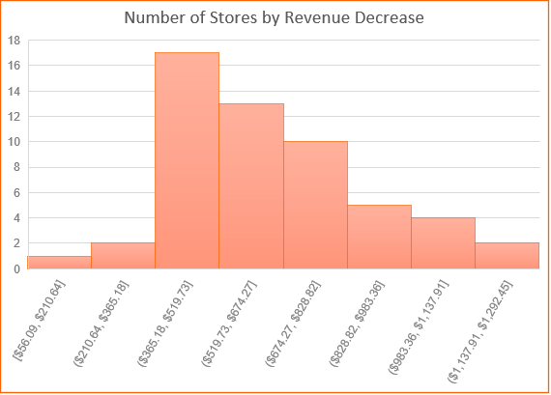
Miami Market Sales Breakdown
** The year-over-year sales discrepancies occurred in Weeks 24, 25, and 26. Thus, the data outlined on this slide only addresses Weeks 24, 25, and 26 in this year and last year.
Sales by Product Breakdown
Product | Current Sales | Last Year Sales | % Change
Faucets | $61,078.91 | $59,678.51 | +2.35%
Generators | $142,543.08 | $158,198.63 | -9.90%
Hand Tools | $77,066.06 | $80,274.23 | -4.00%
Light Bulbs | $73,106.26 | $70,997.81 | +2.97%
Storage Boxes | $44,881.34 | $46,640.60 | -3.77%
Tarps | $70,643.49 | $80,409.25 | -12.15%
Most of the sales “losses” were in Generators and Tarps over the course of a 3-week period (suggesting a tropical storm, hurricane, or other natural disaster hit Miami around Week 24 last year).
There are no noteworthy outliers, so the problem seems to lie with Miami as a whole, not a single store or group of stores.
Notes:
Went into deep-dive on the Miami market
Revenue decreases happened across every store
Generators and Tarps had the largest percentage decrease (Low PPU Change, Indication of Demand Shift)

Slide 4
Miami Market Inventory and Pricing Breakdown
Product | Current Year: PPU | Last Year: PPU | Current Year: Total Inventory | Last Year: Total Inventory
Faucets | $7.47 | $6.76 | 17,717 | 17,468
Generators | $6.75 | $6.44 | 8,414 | 9,762
Hand Tools | $6.90 | $6.56 | 2,050 | 4,697
Light Bulbs | $7.95 | $7.95 | 23,074 | 21,268
Storage Boxes | $11.05 | $6.38 | 9,965 | 11,291
Tarps | $10.24 | $9.76 | 14,511 | 2,811
Significantly lower rate of inventory being sold compared to last year. We can Identify 3 primary differences in the inventory & pricing:
Hand Tool Inventory is Significantly Lower
Storage Box Pricing has Nearly Doubled
There is a Dramatic Excess of Tarp Inventory
Inventory Sold
Current Year | 41%
Last Year | 57%
Notes:
Percentage of our total inventory sold.
Breakdown of Price-Per-Unit Sold/Total Inventory Changes

Slide 5
Recommendations Summary
Problem | Storage Box Sales are Down Significantly
Cause | Price per Unit is too High
Solution | Decrease Price
Birmingham and Nashville Markets are Performing Well
The natural disaster that impacted Miami last year caused inflated market growth.
There are a few current issues with actionable solutions in the Miami Market that we can resolve for immediate impact and increased revenue.
Problem | Hand Tool Sales are Down Significantly
Cause | Insufficient Inventory
Solution | Increase Price & Inventory
Problem | Tarp Sales are Down Significantly
Cause | Excess Inventory, Lower Demand
Solution | Decrease Inventory & Offer Sales
Notes:
General Overview
3 Solvable Problems with their Causes and Solutions

Slide 6
Questions?
Notes:
Questions?

